Slide 1


Status Report Mass Fit and bTagging Efficiency (2016 and 2017)
George Bakas, K.Kousouris, Ioannis Papakrivopoulos

Slide 2
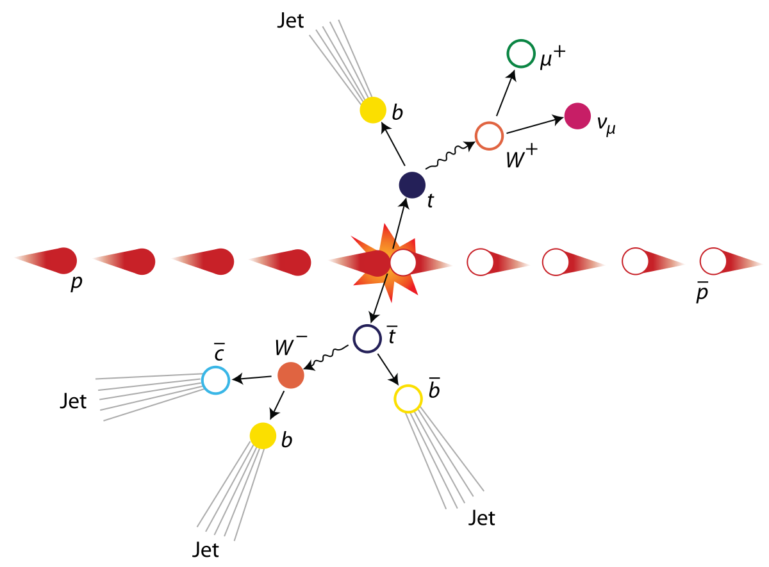
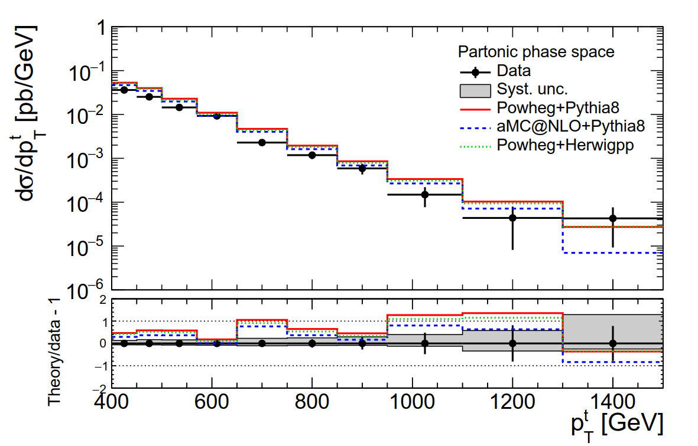
Motivation
Top, anti-top production with fully hadronic
final state.
Trying to identify two big jets that contain the
products of the top/anti-top decay.

Slide 3
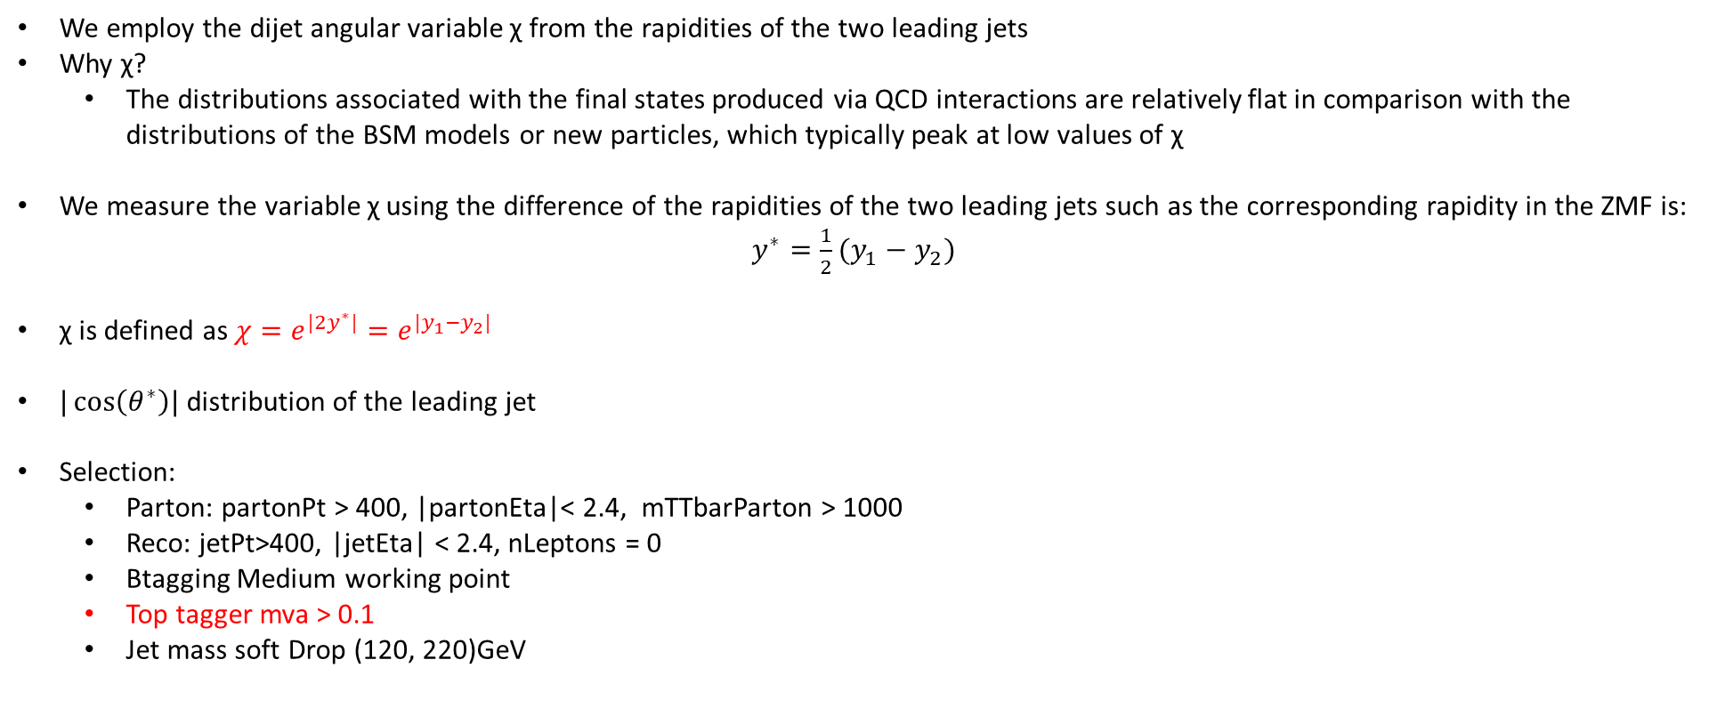
Top Angular Distributions
We employ the dijet angular variable χ from the rapidities of the two leading jets
Why χ?
The distributions associated with the final states produced via QCD interactions are relatively flat in comparison with the distributions of the BSM models or new particles, which typically peak at low values of χ
We measure the variable χ using the difference of the rapidities of the two leading jets such as the corresponding rapidity in the ZMF is: $y^{∗}=\frac{1}{2}(y_{1}−y_{2})$
χ is defined as $χ=e^{{|2y}^{∗}|}=e^{|y_{1}−y_{2}|}$
$|\cos\left(θ^{∗}\right)|$ distribution of the leading jet
Selection:
Parton: partonPt > 400, |partonEta|< 2.4, mTTbarParton > 1000
Reco: jetPt>400, |jetEta| < 2.4, nLeptons = 0
Btagging Medium working point
Top tagger mva > 0.1
Jet mass soft Drop (120, 220)GeV

Slide 4
Overview of Signal Region, Control Region and SR_{A} region
Signal Region (SR): Baseline Selection + topTagger Selection + mass Selection + 2btagged subjets
Control Region (CR): Baseline Selection + topTagger Selection + mass Selection + 0btagged subjets
Extension of Signal Region → SR_{A} = SR – Mass Selection cuts
Selection:
Jet Matching
Baseline Reconstructed level cuts:
nJets > 1
nLeptons = 0
Dijet mass (mJJ) > 1000
Leading and Subleading jet p_{T} > 400
Leading and Subleading absolute jet eta |η|<2.4
Trigger
Baseline Parton cuts:
partonPt[0],[1] > 400
|partonEta[0],[1]| < 2.4
mTTbarParton > 1000
Btagging selection:
bTagging (medium WP deepCSV) (2016: 0.6321, 2017: 0.4941, 2018: 0.4184)
Top Tagger:
Tagger cut (top Tagger) (2016: 0.2, 2017:0.0, 2018: 0.1)

Slide 5
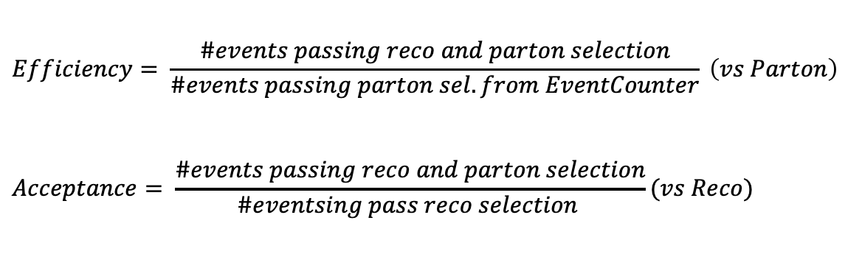
Overview: Discriminator, Efficiency and Acceptance
The discriminator is a BDT trained individually for 2016, 2017 and 2018
Category training: split the sample in categories based on Pt.
Bins:
[400, 600] GeV
[600, 800] GeV
[800, 1200] GeV
[1200, inf) GeV
BDT, used variables:
Leading and Sub-leading subjet mass
N-Subjetiness variables (tau1, tau2, tau3)
fraction of the jetPt over the total pt sum of the event.
Energy correlation functions (ecfB1N2,ecfB1N3, ecfB2N2, ecfB2N3)
BDT Output consistency for the 3 years
Calculation of Efficiency and acceptance for each year
We choose the WP’s for each year so that the leading jet p_{T} efficiency is similar for all years
$$Efficiency= \frac{\#events passing reco and parton selection}{\#events passing parton sel. from EventCounter} \left(vs Parton\right)$$
$$Acceptance= \frac{\#events passing reco and parton selection}{\#eventsing pass reco selection }(vs Reco)$$

Slide 6
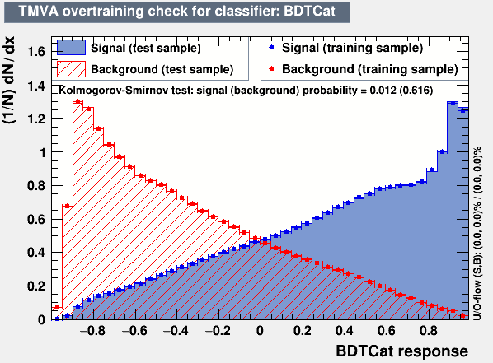
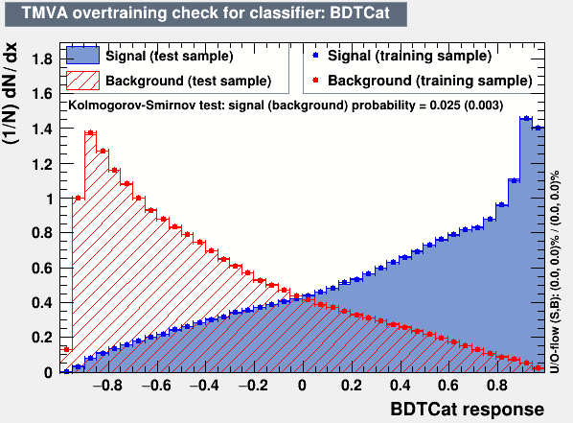
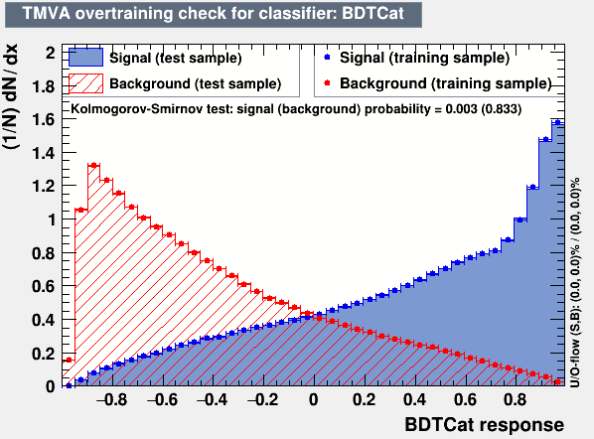
Training Outputs
2016
2017
2018

Slide 7
Efficiency and Acceptance for 2016, 2017 and 2018 and previous 2016 analysis

Slide 8
Btagging efficiency in eta, pT_{subJet} phase space
2016
2017

Slide 9
Btagging efficiency in eta, pT_{subJet} phase space
2018
2016

Slide 10
Efficiency, Acceptance for χ

Slide 11
Efficiency, Acceptance for |cos(θ*)|

Slide 12
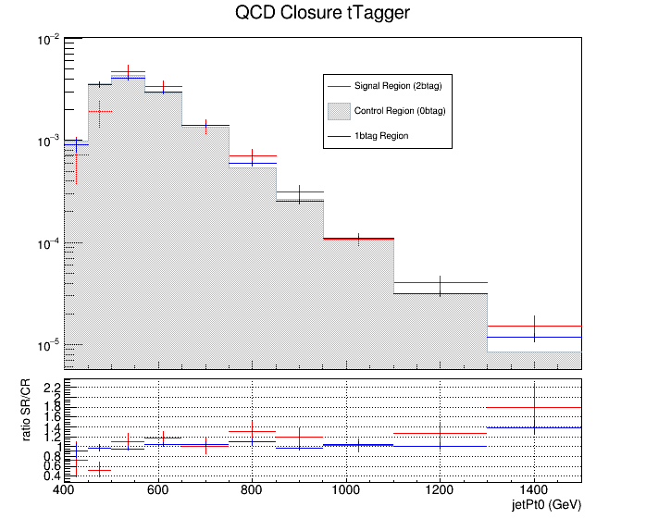
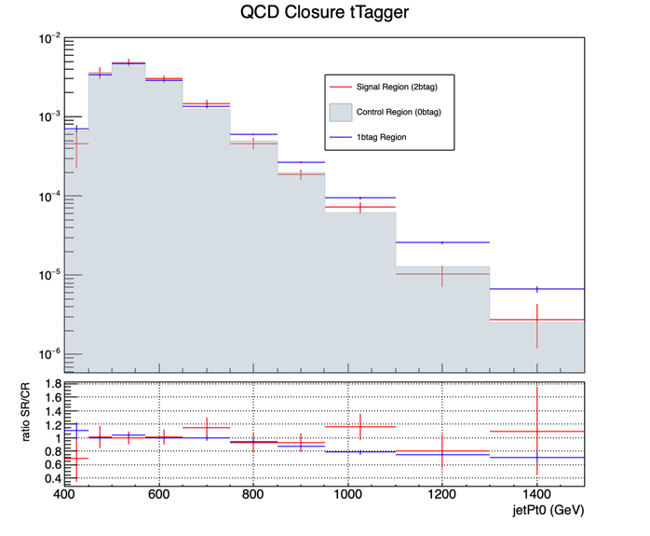
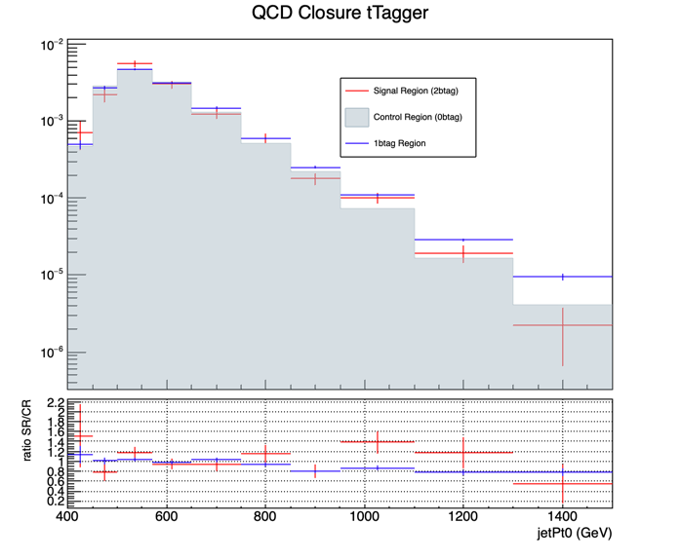
QCD Closure Tests ’16, ‘17, ’18 jetPt0
2016
2017
2018

Slide 13
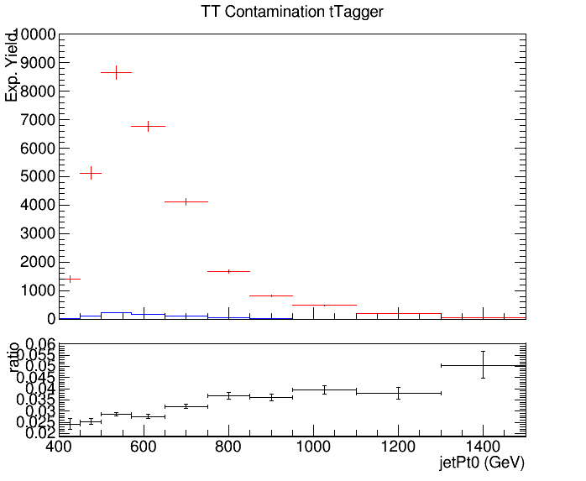
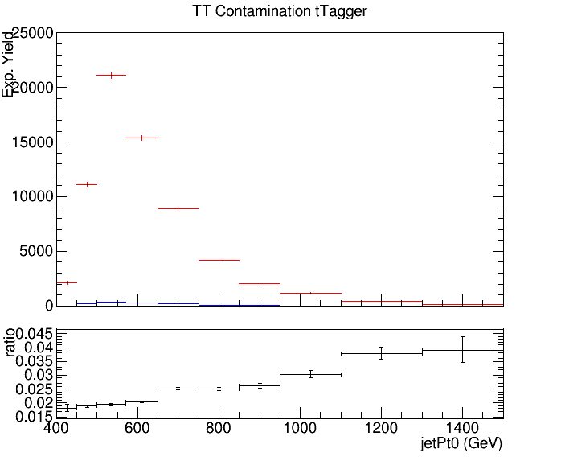
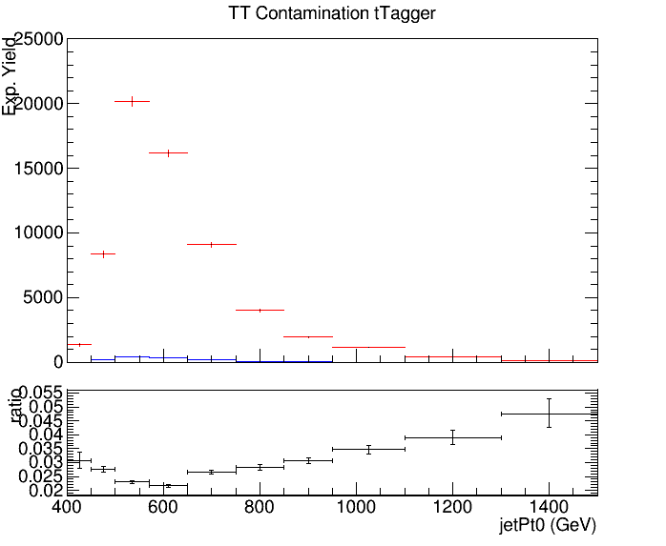
CR Contamination ’16,’17,’18 jetPt0
Control Region QCD sample
Control Region TT sample
2016
2017
2018

Slide 14
QCD Closure Tests ’16, ‘17, ’18 χ
2016
2017
2018

Slide 15
CR Contamination ’16,’17,’18 χ
Control Region QCD sample
Control Region TT sample
2016
2017
2018

Slide 16
QCD Closure Tests ’16, ‘17, ’18 |cos(θ*)|
2016
2017
2018

Slide 17
CR Contamination ’16,’17,’18 |cos(θ*)|
Control Region QCD sample
Control Region TT sample
2016
2017
2018

Slide 18
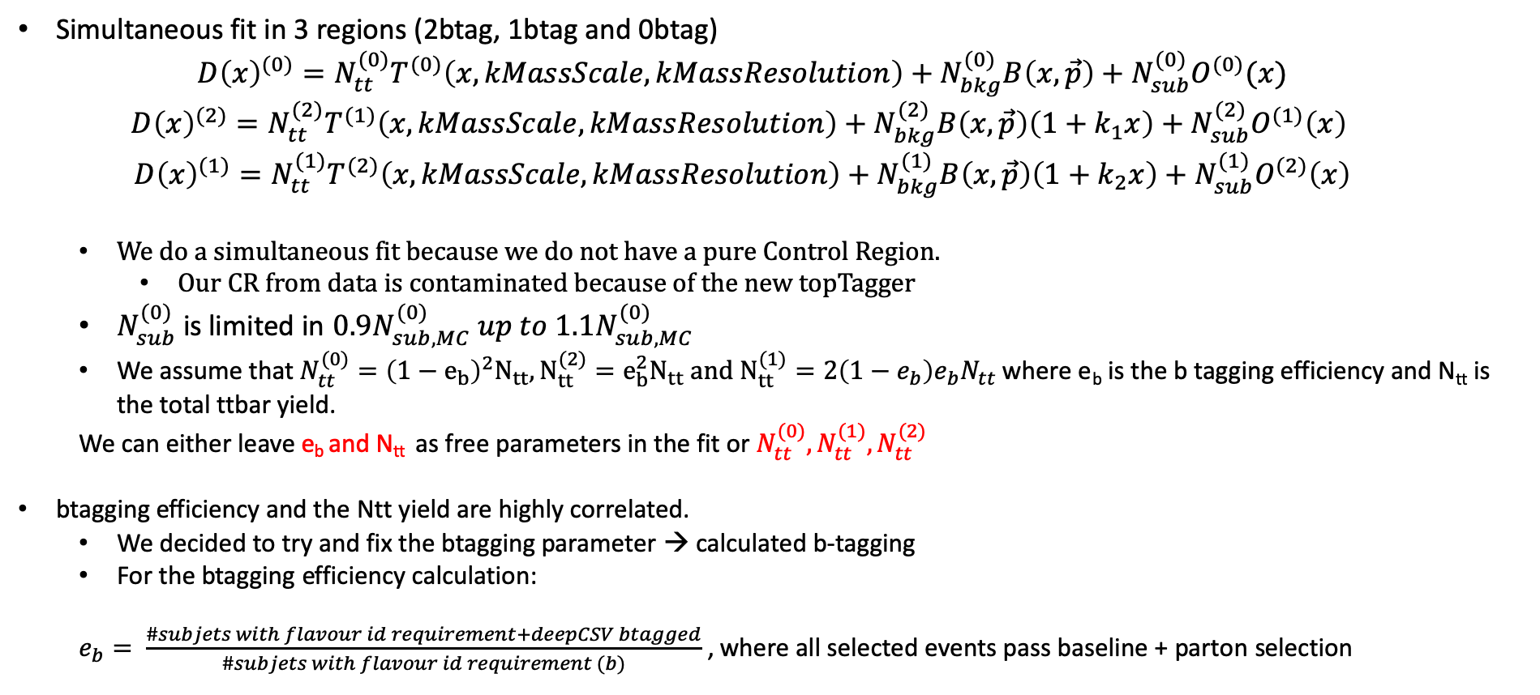
Simultaneous Fit in 3 regions
Simultaneous fit in 3 regions (2btag, 1btag and 0btag)
$$D{\left(x\right)}^{(0)}=N_{tt}^{(0)}T^{(0)}\left(x, kMassScale, kMassResolution\right)+N_{bkg}^{(0)}B\left(x,\vec{p}\right)+N_{sub}^{(0)}O^{(0)}(x)$$
$$D{\left(x\right)}^{(2)}=N_{tt}^{(2)}T^{(1)}\left(x,kMassScale, kMassResolution\right)+N_{bkg}^{(2)}B\left(x,\vec{p}\right)\left(1+k_{1}x\right)+N_{sub}^{(2)}O^{(1)}\left(x\right)$$
$$D{\left(x\right)}^{(1)}=N_{tt}^{(1)}T^{(2)}\left(x,kMassScale, kMassResolution\right)+N_{bkg}^{(1)}B\left(x,\vec{p}\right)\left(1+k_{2}x\right)+N_{sub}^{(1)}O^{(2)}\left(x\right)$$
We do a simultaneous fit because we do not have a pure Control Region.
Our CR from data is contaminated because of the new topTagger
$N_{sub}^{(0)}$ is limited in $0.9N_{sub,MC}^{(0)} up to 1.1N_{sub,MC}^{(0)}$
We assume that $N_{tt}^{(0)}={\left(1−e_{b}\right)}^{2}N_{tt}, N_{tt}^{(2)}=e_{b}^{2}N_{tt} and N_{tt}^{(1)}=2\left(1−e_{b}\right)e_{b}N_{tt}$ where e_{b} is the b tagging efficiency and N_{tt} is the total ttbar yield.
We can either leave e_{b} and N_{tt} as free parameters in the fit or $N_{tt}^{(0)},N_{tt}^{(1)},N_{tt}^{(2)}$
btagging efficiency and the Ntt yield are highly correlated.
We decided to try and fix the btagging parameter → calculated b-tagging
For the btagging efficiency calculation:
$e_{b}= \frac{\#subjets with flavour id requirement+deepCSV btagged}{\#subjets with flavour id requirement (b)}$ , where all selected events pass baseline + parton selection

Slide 19
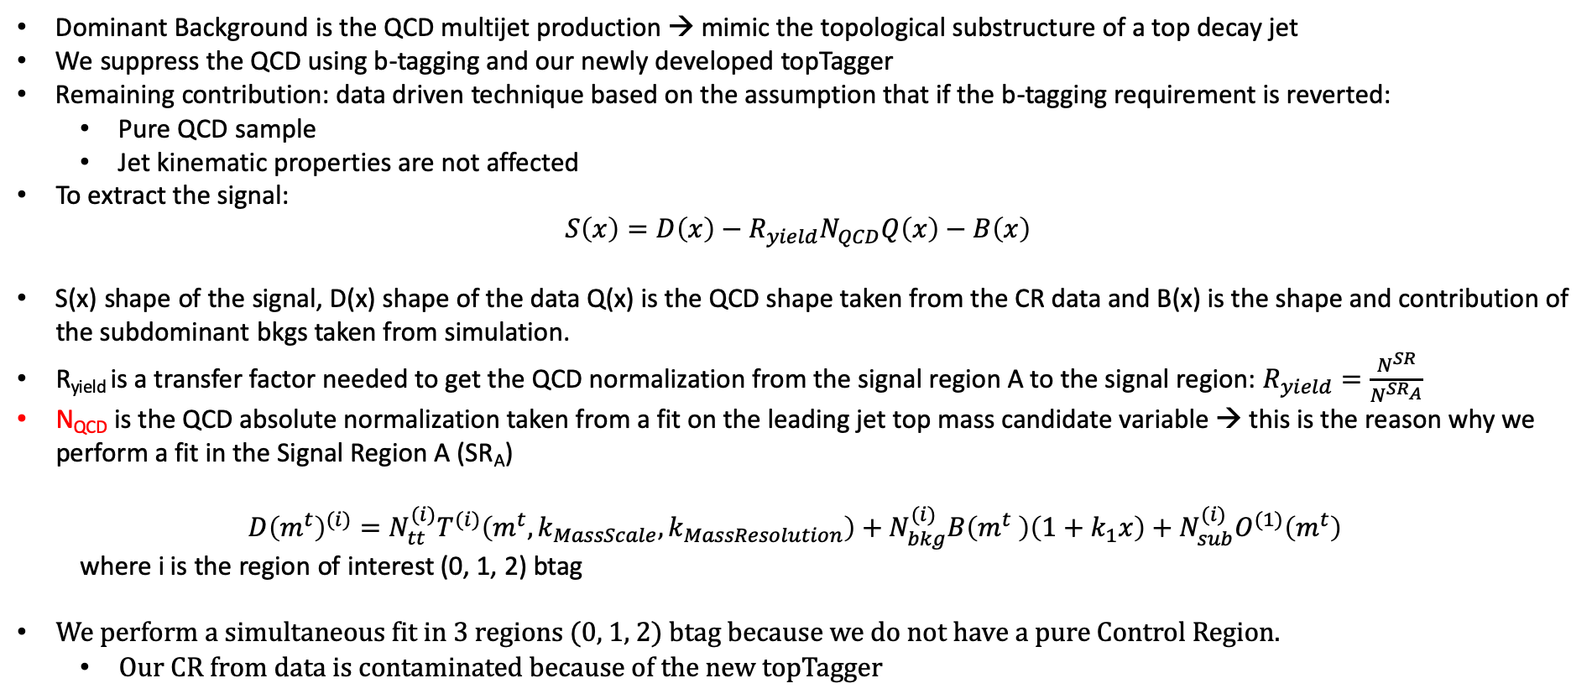
Signal Extraction
Dominant Background is the QCD multijet production → mimic the topological substructure of a top decay jet
We suppress the QCD using b-tagging and our newly developed topTagger
Remaining contribution: data driven technique based on the assumption that if the b-tagging requirement is reverted:
Pure QCD sample
Jet kinematic properties are not affected
To extract the signal:
$$S\left(x\right)=D\left(x\right)−R_{yield}N_{QCD}Q\left(x\right)−B\left(x\right)$$
S(x) shape of the signal, D(x) shape of the data Q(x) is the QCD shape taken from the CR data and B(x) is the shape and contribution of the subdominant bkgs taken from simulation.
R_{yield} is a transfer factor needed to get the QCD normalization from the signal region A to the signal region: $R_{yield}=\frac{N^{SR}}{N^{SR_{A}}}$
N_{QCD} is the QCD absolute normalization taken from a fit on the leading jet top mass candidate variable → this is the reason why we perform a fit in the Signal Region A (SR_{A})
$$D{\left(m^{t}\right)}^{(i)}=N_{tt}^{(i)}T^{(i)}\left(m^{t},k_{MassScale}, k_{MassResolution}\right)+N_{bkg}^{(i)}B\left(m^{t} \right)\left(1+k_{1}x\right)+N_{sub}^{(i)}O^{(1)}\left(m^{t}\right)$$
where i is the region of interest (0, 1, 2) btag
We perform a simultaneous fit in 3 regions (0, 1, 2) btag because we do not have a pure Control Region.
Our CR from data is contaminated because of the new topTagger

Slide 20
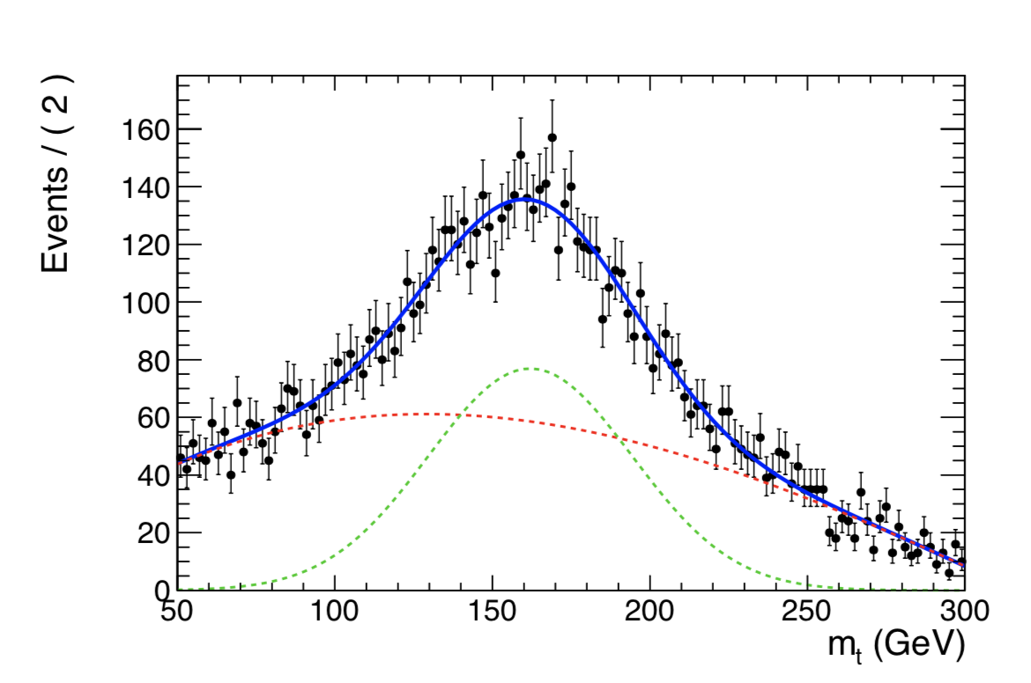
Template Fit results in CR
2016
2016
2017
2018

Slide 21
Simultaneous Fit in 3 regions for 2017 and 2016 when eb is fixed
Signal Region (2btag) (2017)
Signal Region (2btag) (2016)
Result of the template fit on data in SR. The red line shows the ttbar contribution, the green line shows the QCD, and the brown line shows the subdominant backgrounds

Slide 22
Simultaneous Fit in 3 regions for 2017 and 2016 when eb is fixed
Control Region (0btag) (2017)
Control Region (0btag) (2016)
Result of the template fit on data in CR. The red line shows the tt contribution, the green line shows the QCD, and the brown line shows the subdominant backgrounds

Slide 23
Simultaneous Fit in 3 regions for 2017 and 2016 (1btag Region)
2017
2016

Slide 24
Simultaneous Fit in 3 regions for 2017 and 2018 when eb is fixed
Signal Region (2btag) (2017)
Signal Region (2btag) (2018)
Result of the template fit on data in SR. The red line shows the ttbar contribution, the green line shows the QCD, and the brown line shows the subdominant backgrounds

Slide 25
Simultaneous Fit in 3 regions for 2017 and 2018 when eb is fixed
Control Region (0btag) (2017)
Control Region (0btag) (2018)
Result of the template fit on data in CR. The red line shows the tt contribution, the green line shows the QCD, and the brown line shows the subdominant backgrounds

Slide 26
Simultaneous Fit in 3 regions for 2017 and 2018 (1btag Region)
2017
2018

Slide 27
Simultaneous Fit in 3 regions for 2016 ,2017 and 2018 (nuisances) with fixed eb
2016
2017
2018
Floating Parameter FinalValue +/- Error
-------------------- --------------------------
kMassResol 9.2150e-01 +/- 2.07e-02
kMassScale 1.0023e+00 +/- 1.60e-03
kQCD_1b 6.3680e-03 +/- 4.58e-04
kQCD_2b 5.9385e-02 +/- 3.48e-02
nFitBkg_0b 4.5269e+03 +/- 4.25e+01
nFitBkg_1b 2.3356e+03 +/- 2.73e+02
nFitBkg_2b 2.0703e+02 +/- 2.32e+01
nFitQCD_0b 8.8323e+04 +/- 3.13e+02
nFitQCD_1b 3.0542e+04 +/- 2.62e+02
nFitQCD_2b 2.8400e+03 +/- 1.55e+02
nFitSig 1.3955e+04 +/- 3.69e+02
Floating Parameter FinalValue +/- Error
-------------------- --------------------------
kMassResol 9.8167e-01 +/- 2.54e-02
kMassScale 9.8694e-01 +/- 1.88e-03
kQCD_1b 4.6427e-03 +/- 3.05e-04
kQCD_2b 1.1491e-02 +/- 3.97e-03
nFitBkg_0b 4.0852e+03 +/- 4.44e+01
nFitBkg_1b 2.0768e+03 +/- 6.62e+01
nFitBkg_2b 2.1331e+02 +/- 4.46e+01
nFitQCD_0b 1.5591e+05 +/- 4.08e+02
nFitQCD_1b 3.7752e+04 +/- 2.83e+02
nFitQCD_2b 2.1182e+03 +/- 1.33e+02
nFitSig 1.3738e+04 +/- 3.84e+02
Floating Parameter FinalValue +/- Error
-------------------- --------------------------
kMassResol 9.8988e-01 +/- 2.10e-02
kMassScale 9.9003e-01 +/- 1.48e-03
kQCD_1b 4.0033e-03 +/- 2.41e-04
kQCD_2b 1.0290e-02 +/- 2.65e-03
nFitBkg_0b 4.1842e+03 +/- 4.02e+01
nFitBkg_1b 2.6492e+03 +/- 6.75e+01
nFitBkg_2b 4.1749e+02 +/- 3.89e+01
nFitQCD_0b 1.6973e+05 +/- 4.26e+02
nFitQCD_1b 5.0264e+04 +/- 3.25e+02
nFitQCD_2b 3.7944e+03 +/- 1.81e+02
nFitSig 2.0663e+04 +/- 4.54e+02
Ntt expected = 16351.2
Ntt observed = 13955.3
r = 0.85347
Ntt expected = 23720.7
Ntt observed = 13737.8
r = 0.579147
Ntt expected = 30676.2
Ntt observed = 20662.5
r = 0.673567

Slide 28
We are checking for different values of e_{b} , the output of the N⁽²⁾_{QCD} for 2016 and 2017
Points of interest are from 0.4 - 0.8 but especially 0.5-0.7 for 2016 and 0.45-0.6 5 for 2017
Calculated btagging efficiency for both years
btagging efficiency when the parameter is set as a free nuisance in the simultaneous fit
2016: eb (fit) ≈ 0.56 and eb (calculated) ≈0.63
2017: eb(fit) ≈ 0.48 and eb (calculated) ≈ 0.61
2018: eb(fit) ≈ 0.52 and eb (calculated) ≈ 0.63

Slide 29
BACKUP SLIDES

Slide 30
Btagging purity
2016
2017
2018
Purity ≈ 0. 894
Purity ≈ 0.915
Purity ≈ 0.903

Slide 31
2016
2017
2018

Slide 32
Correlation plots N_{QCD(2)} vs all nuisances from fit when eb runs free for 2016

Slide 33
Correlation plots N_{QCD(2)} vs all nuisances from fit when eb runs free for 2016

Slide 34
Correlation plots N_{QCD(2)} vs all nuisances from fit when eb runs free for 2017

Slide 35
Correlation plots N_{QCD(2)} vs all nuisances from fit when eb runs free for 2017

Slide 36
Correlation plots N_{QCD(2)} vs all nuisances from fit when eb runs free for 2018

Slide 37
Correlation plots N_{QCD(2)} vs all nuisances from fit when eb runs free for 2018

Slide 38
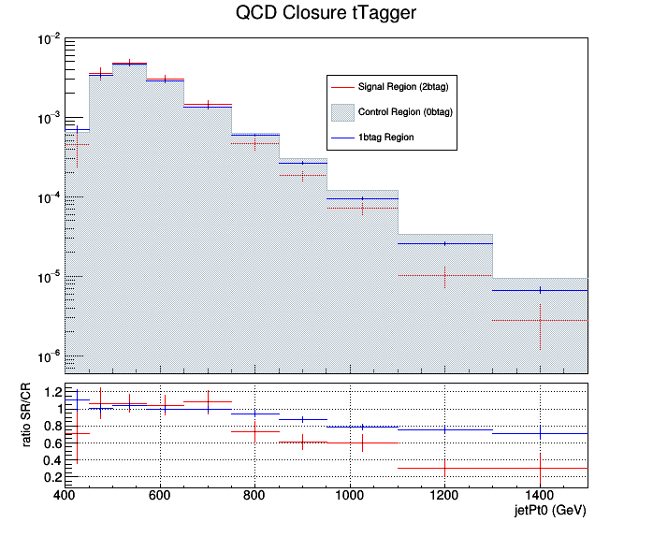
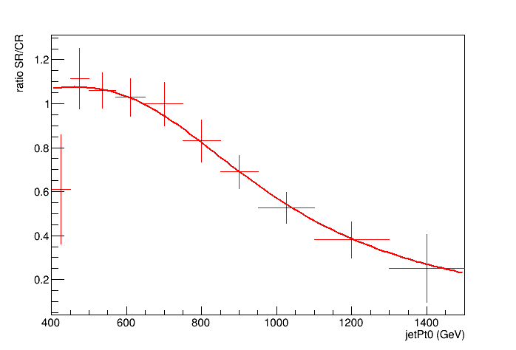
2017 QCD Closure and the fit ratio
Discovered shape in the SR/CR
Fit the ratio with the function:
Output of the new QCD closure

Slide 39
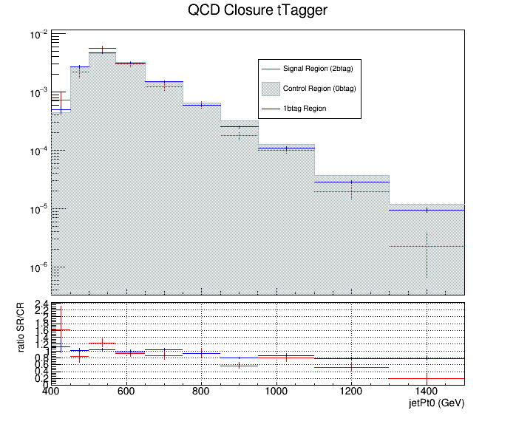
2018 QCD Closure and the fit ratio
Discovered shape in the SR/CR
Fit the ratio with the function:
Output of the new QCD closure

Slide 40
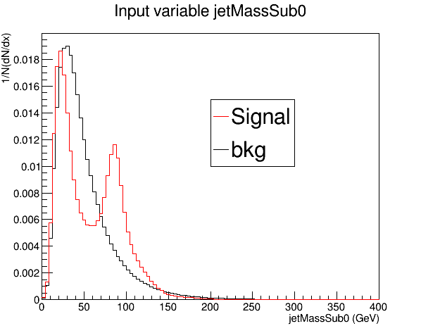
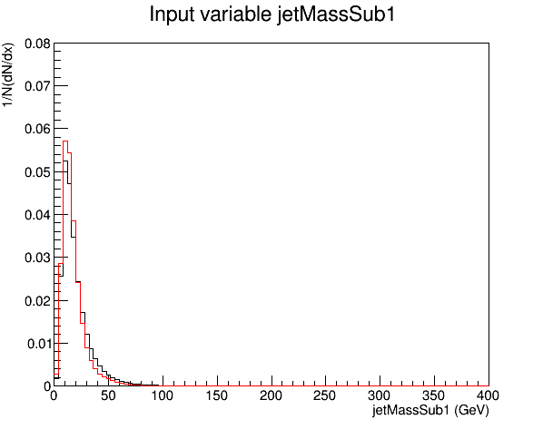
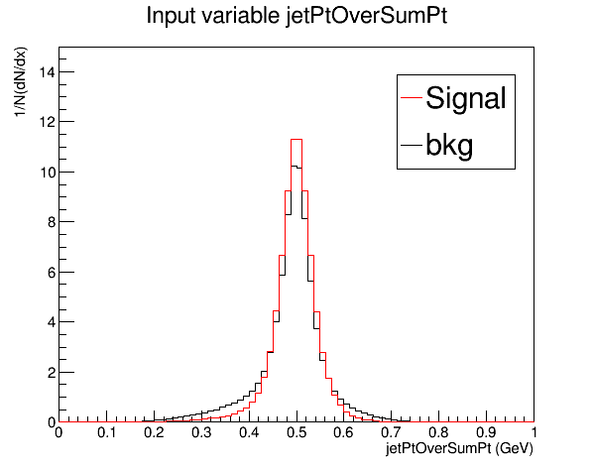
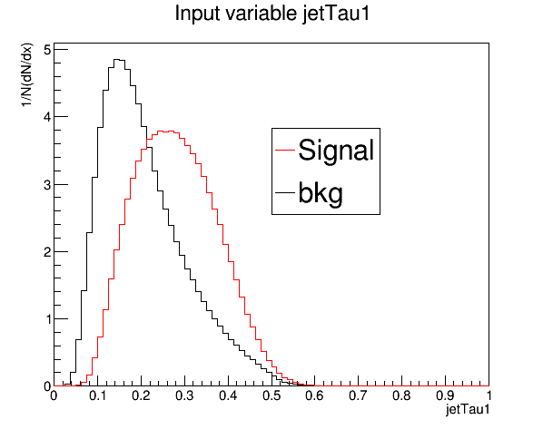
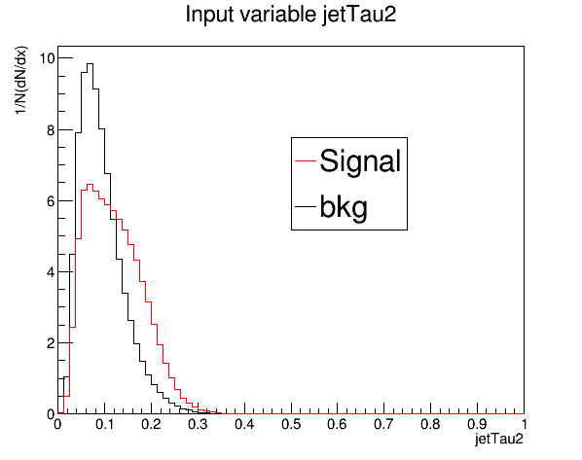
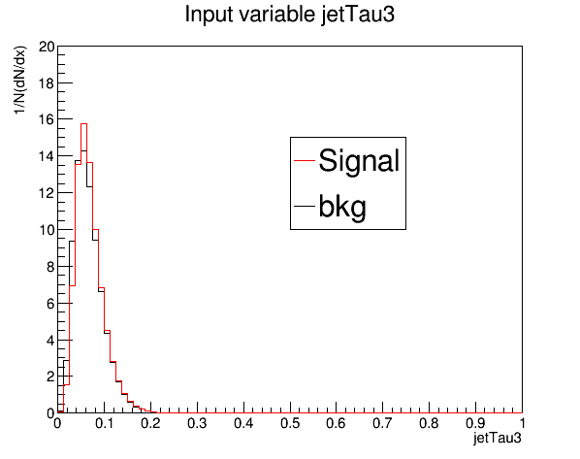
Training variables 2017

Slide 41
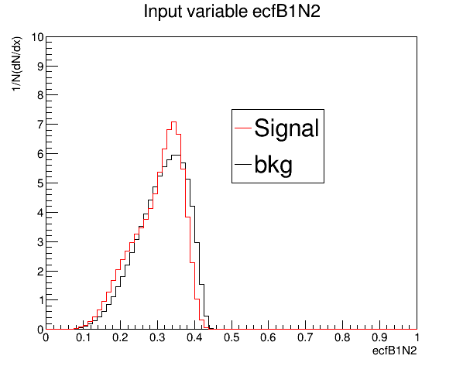
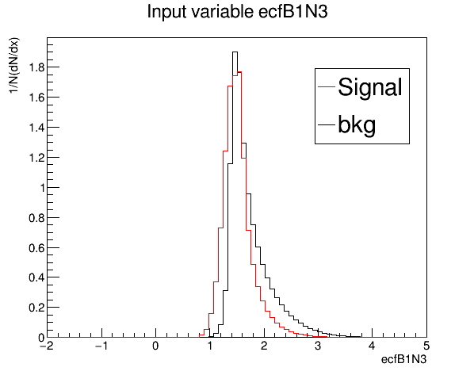
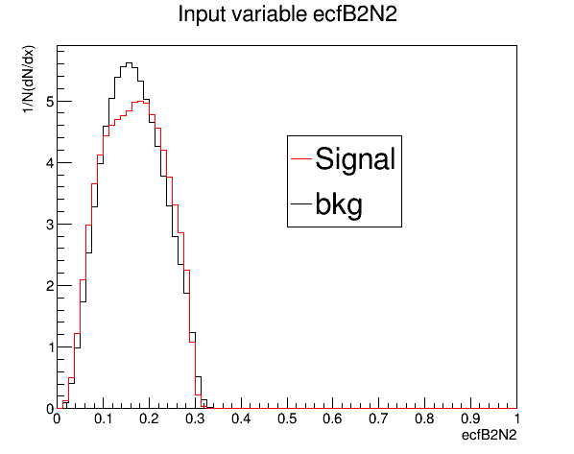
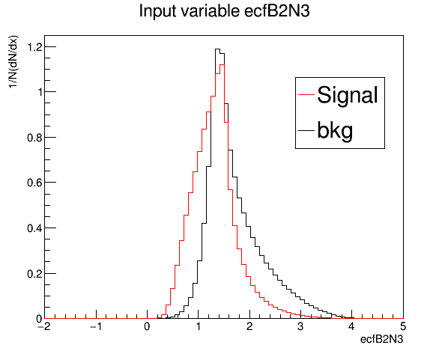
Training variables 2017

